Slide 1

Model Trainer Behavior

Slide 2

Empowering Mankind
MySkill - Empowering womanhood, is program with a vision to give a platform to all the women for diversifying their existing skills to meet today's challenges. MySkill aims at building actual competencies to achieve their highest desired level of independence and inclusion in their communities.
MySkill has partnered with institutes who have a proven track record of training and empowering women through various educational and experiential learning in the past.
MySkill offers a platform for all aspiring women who want to have a greater expansion in professional and personal growth which in turn contribute to structural transformation and economic growth by enhancing employability.

Slide 3
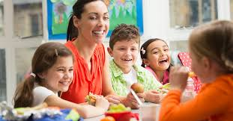
AGENDA
What is a Model Behavior?
Introducing Yourself to Parents
Introducing Yourself to Children
Encouraging Children to Follow Instructions
Encouragement for Age Group 6-9
Encouragement for Age Group 10-12
Lightening Up the Classroom Environment
The Importance of Being a Role Model
Conclusion and Thank You

Slide 4
What is a Model Behavior?
Model behavior is defined as behavior that is morally justifiable or right.
It is characterized by accepted standards of morality, justice, virtue, or uprightness.
Model behavior reflects how you present yourself in a manner that is liked and accepted by everyone around you.

Slide 5

Introducing Yourself to Parents
Plus tip:
You can customize this slide by adding personal anecdotes or examples of successful introductions you've made in the past.
Smile and Make Eye Contact
Greet Them Politely
Introduce Yourself
Approach the parents with a warm smile and make eye contact.
Start by greeting the parents with a polite 'Hello' or 'Hi.'.
Clearly state your name and your relationship with their child or the context in which you're meeting them.
Express Pleasure in Meeting Them
Be Approachable
Keep It Brief
Follow your introduction with a positive statement about meeting them.
Show genuine interest in the child and their family. Ask them how their day is going.
Keep your introduction short. Avoid overwhelming them with too much information at once.

Slide 6
Introducing Yourself to Children
Plus tip:
Consider adding examples of props or visual aids that have been successful in your own introductions to make the content more relatable.
Use a Warm Greeting
State Your Name
Make it Interactive
Welcome the children with a cheerful 'Hello' or 'Good evening'.
Introduce yourself by stating your name clearly. You can also mention your role, such as 'I'm Miss/Mr. [Your Name], and I'm going to be your instructor today.'
'My name is Miss/Mr. [Your Name], and I'm here to be your friend and help you learn and have fun!'
Encourage Participation
Be Enthusiastic
Use Props or Aids
Invite the children to introduce themselves as well. You could say, 'Now it's your turn! Can you tell me your name and something you like to do?'
Show genuine enthusiasm about meeting the children and teaching them. Your enthusiasm can be contagious and help create a positive learning environment.
For visual learners or younger children, use props or visual aids to make your introduction more engaging, such as a picture of yourself with your name written on it.

Slide 7
Encouraging Children to Follow Instructions
Plus tip:
Consider including examples of visual aids or specific activities to illustrate these methods more clearly.
Use Simple and Clear Instructions
Utilize Visual Aids
Engage in Playful Learning
Keep instructions short, clear, and easy to understand. Use simple language and avoid complex sentences.
Use visual aids such as pictures, drawings, or gestures to reinforce your instructions. Children in this age group often respond well to visual cues.
Incorporate instructions into games, songs, or playful activities. Children learn best through hands-on experiences and interactive play.

Slide 8
Encouragement for Age Group 6-9
Set Clear Expectations
Use Sequential Instructions
Clearly communicate goals and explain the reasons behind the instructions. Children in this age group are more likely to follow instructions when they understand the purpose.
Break down tasks into smaller steps and provide instructions sequentially. This helps children process information more effectively.
Positive Reinforcement
Encourage Independence
Continue to use praise and positive reinforcement to motivate children. Acknowledge their efforts and accomplishments.
Foster independence by encouraging children to take initiative and problem-solve on their own. Offer guidance and support as needed.
Plus tip:
Consider adapting examples to reflect the specific context or subjects you teach, ensuring relevance to your audience.

Slide 9
Encouragement for Age Group 10-12
Explain the 'Why'
Set Clear Goals
Provide explanations for instructions and involve children in decision-making processes. Encourage critical thinking and discussion.
Clearly communicate goals and expectations. Encourage children to set their own goals and monitor their progress.
Encourage Responsibility
Effective Communication
Assign age-appropriate tasks and responsibilities to promote a sense of accountability. Allow children to take on roles and contribute to group activities.
Practice active listening and open communication. Encourage children to express their thoughts, feelings, and concerns.
Plus tip:
Customize this slide by including specific examples of goals or responsibilities that are relevant to your context. Consider sharing personal experiences to illustrate effective communication.

Slide 10
Lightening Up the Classroom Environment
Plus tip:
Consider adding specific examples of humor or stories that have worked well in your classroom to personalize the content.
Use Humor
Tell Stories
Encourage Creativity
Incorporate jokes, puns, or light-hearted anecdotes related to the lesson topic to make the class more enjoyable. Be mindful of the appropriateness of humor and ensure it doesn't distract from the learning objectives.
Share relevant and engaging stories that relate to the lesson material or students' interests. Personal anecdotes or funny stories can capture students' attention and make the content more relatable.
Provide opportunities for students to express their creativity through projects, presentations, or creative assignments. Allow students to showcase their talents and unique perspectives.

Slide 11
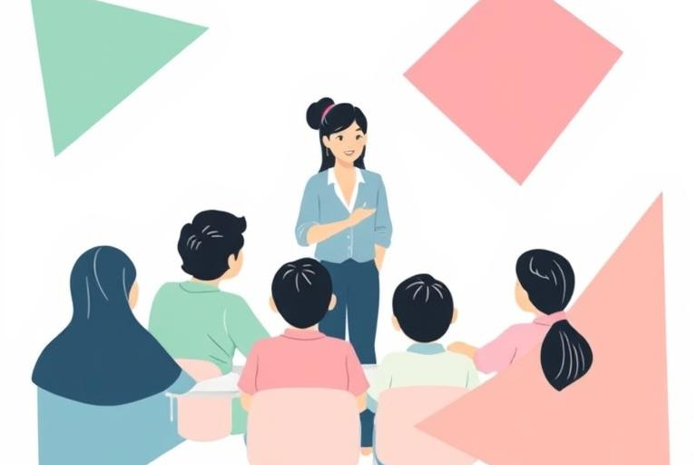
The Importance of Being a Role Model
Why Being a Role Model Matters
Being a role model is crucial for guiding children in their development. Children learn behaviors through observation, so demonstrating positive actions is essential.
Leading by example sets a standard for expected behavior. When educators embody qualities like respect, kindness, and responsibility, students are more likely to emulate these traits.
Demonstrating desired behaviors helps in building trust and rapport with students. This fosters a safe and nurturing environment where children feel valued and understood.

Slide 12
Conclusion and Thank You
In this presentation, we explored the concept of model behavior, emphasizing that it is defined as "behavior that is morally justifiable or right" and characterized by accepted standards of morality and justice. We discussed effective strategies for introducing oneself to both parents and children, highlighting the importance of approachability and positive interactions. Techniques for encouraging children to follow instructions were outlined, tailored to different age groups, emphasizing the need for clear communication and positive reinforcement. Additionally, we covered how to lighten the classroom environment through humor and creativity. Thank you for your attention and engagement throughout this presentation!
Plus tip:
Consider adding a personal touch or anecdote to conclude your presentation, making it more relatable to your audience.

Slide 13

MySkool is an inspiration for schools, teachers, parents and students to excel in life. It is a message that ‘good is always appreciated.’ It is a push towards self motivation, an opportunity to see how others are growing and a chance to appreciate fellow human beings.

